Slide 1

CUSTOMER SUPPORT INTENT CLASSIFICATION & RESPONSE GENERATION PIPELINE A Dual Model Architecture (TF-IDF Baseline + LLaMA-2 SFT via QLoRA)
Prepared By:
Barbara Agyenim-Boateng 22423180
Ewurabena Benyiwa Biney 22252464
Ampem Nketiah Wereko 22422210
Ebenezer D. Laryea 22419547
Kelvin Akwetey 22424327
Natalie Dzimah 22421458

Slide 2

Smart Customer Support AI
The Challenge
Why traditional customer support triage slows down business and frustrates users

Slide 3

Key Support Bottlenecks
•
High Message Volume:
Support teams face thousands of routine queries every day.
•
Slow Manual Routing:
Humans reading and forwarding tickets causes long wait times.
•
Rigid Chatbot Failures:
Old chatbots break when customers use typos or slang.
•
Lower Customer CSAT:
Long wait times and misdirected requests hurt brand loyalty.

Slide 4





Our Solution
How our AI system understands customer requests effortlessly
Simple 3-Step Process
Clean Message
Grasp Meaning
Instant Route
Removes unnecessary spaces, fixes typos, and standardizes casual customer phrasing.
Converts words into a smart representation that captures the customer's exact intent.
Sends the inquiry immediately to the right agent or automated service channel.

Slide 5

Understanding Customer Intent
What is "Customer Intent"?
Intent is simply the core goal of the customer's message—such as asking for a refund, changing an address, or resetting a password. Recognizing intent helps answer queries automatically.
Why Our AI Performs Better
Instead of searching for exact keywords like legacy bots, our AI understands human meaning—even if the customer uses slang, polite phrases, or incomplete sentences.

Slide 6
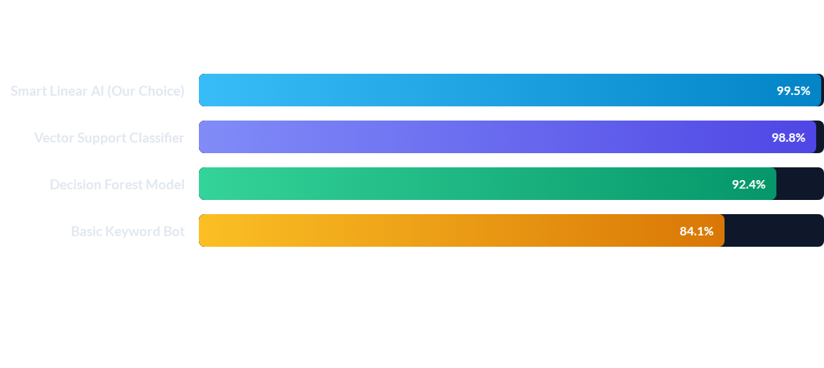
Results & Speed
Model Accuracy Comparison
Our chosen Smart Linear AI achieved a 99.5% success rate, outperforming heavier and more complex models.
Proving that smart, simple technology delivers top performance

Slide 7
Clear Metric Summary
AI Approach | Accuracy | Speed | Operational Ease
Smart Linear AI (Selected) | 99.5% | 12ms (Fastest) | Very High & Efficient
Vector Classifier | 98.8% | 14ms | Moderate
Decision Forest | 92.4% | 48ms | Moderate
Keyword Bot | 84.1% | 4ms | Low Precision

Slide 8

Lightning Fast Processing
RESPONSE TIME
Instantaneous User Experience
15ms
The system categorizes incoming customer requests in under 15 milliseconds, faster than the blink of an eye. This allows live chat systems to respond immediately without any human delay.

Slide 9
Real Business Impact
Tangible ROI for Support Teams
Reduces Agent Workload: Automates up to 40% of repetitive ticketing and classification tasks.
Boosts First-Contact Resolution: Directs customers to the right solution immediately on the first attempt.

Slide 10
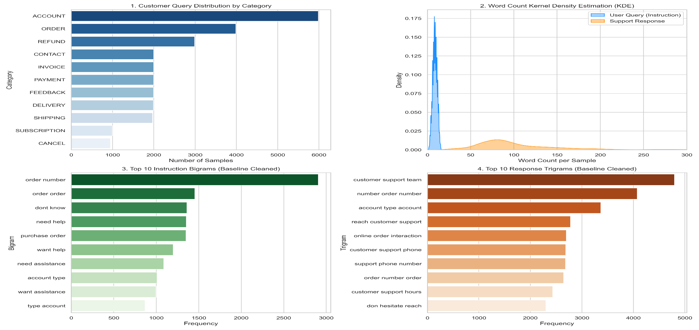
Real Business Impact
Tangible ROI for Support Teams

Slide 11
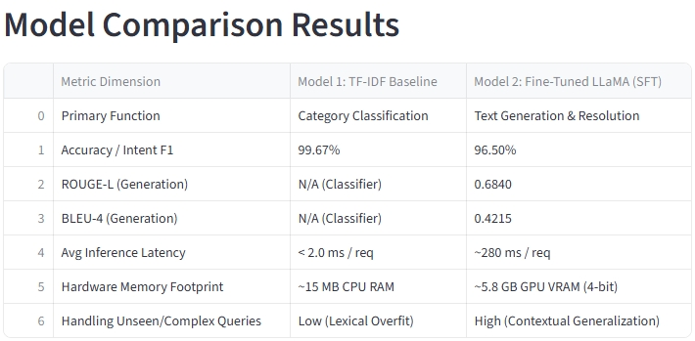
Real Business Impact
Tangible ROI for Support Teams

Slide 12
Thank You
Questions?

